Slide 1
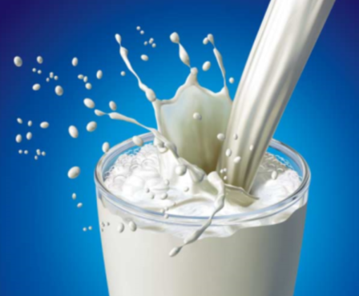
Girl’s Health Focus:
Calcium and Bone Health
Amanda Haney, Dietetic Intern September 2011
Notes:
In this session we will be talking about bones! We will discuss what our bones are made of, what happens when they are weak, how we can keep bones strong with calcium, calcium in the diet, how much a teenage girl needs, and other ways to prevent the destruction of calcium in your body.

Slide 2
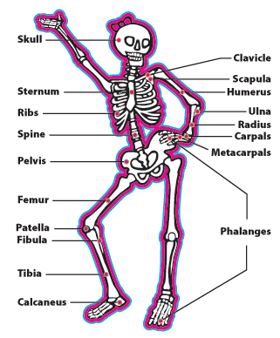
All About Bones…
There are over 200 bones inside your body.
Bones hold up your muscles and protect all your organs.
Without bones we would just be giant blobs!!
Image from http://www.bestbonesforever.gov/bbf/facts.cfm

Slide 3
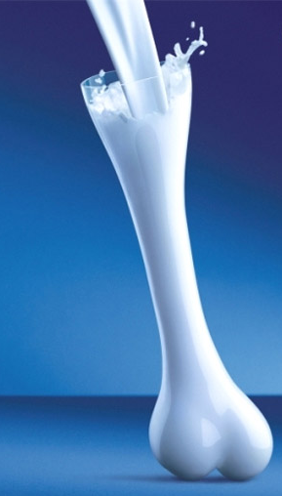
What makes bones strong?
Bones are made of two things: collagen and calcium phosphate.
Calcium from your foods travels through your blood stream and deposits in bones. More calcium means stronger bones!
Vitamin D is also important to eat with calcium because it helps the calcium from your foods attach to your bones.

Slide 4
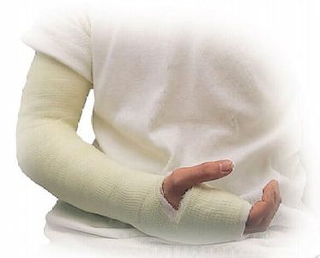
What happens to weak bones?
When bones don’t have enough calcium, they become weak and brittle.
Weak bones lead to bone fractures.
Muscles cannot become as strong when the bones that support them are weak.

Slide 5
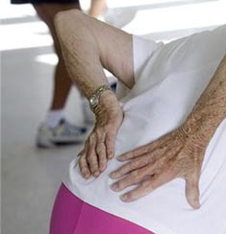
Osteoporosis
This disease is caused by weak bones that continue to weaken as you grow older.
It can cause many problems such as:
    Bone pain and tenderness
    Weak muscles
    Bone fractures
    Neck and back pain
    Growing shorter over time
    Hunched Back

Slide 6
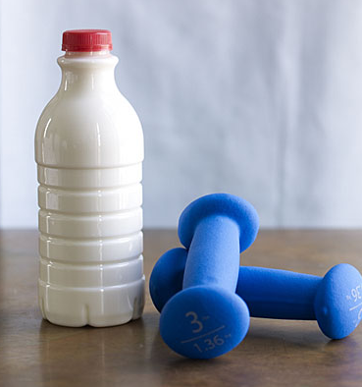
Old bones
As we grow older, our bones grow old too.
Your bones are still developing and getting stronger each day. They will continue to grow until you are just 20 years old.
At 20 years old, your bones are the strongest they will ever be.
Making strong bones today will help you prevent weak bones and osteoporosis in the future.

Slide 7
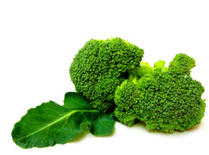
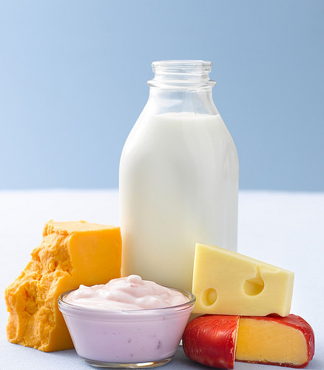
Calcium in your food
There are many foods that contain calcium.
Eating these foods will help you build strong bones
    Milk
    Plain or fruit yogurt
    Frozen yogurt
    Cheese
    Broccoli
    Kale
    White beans
    Almonds

Slide 8
What about lactose intolerance?
Some girls have lactose intolerance. This means they cannot drink milk or may feel sick after eating milk products.
Absense of the enzyme lactase means your body can’t digest lactose
  Look for milk, yogurt, and cheese products that are labeled “lactose-free.”
  Lactose-free dairy products have the same amount of calcium as regular milk products.

Slide 9
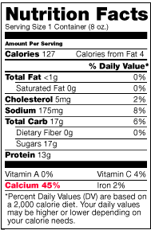
How much Calcium do I need?
Girls 9-18 years old need 1,300 mg of calcium each day.
Food labels do not show mg of calcium, they show %daily value.
  1,300mg = 130% Daily Value
  Add your food labels each day to get all 130% of your calcium needs!!
Image from http://www.bestbonesforever.gov/best_foods/food_labels.cfm
Notes:
Daily values are based upon the average healthy adult. Since teenagers need more calcium than adults, your % Daily value is greater than 100%.

Slide 10
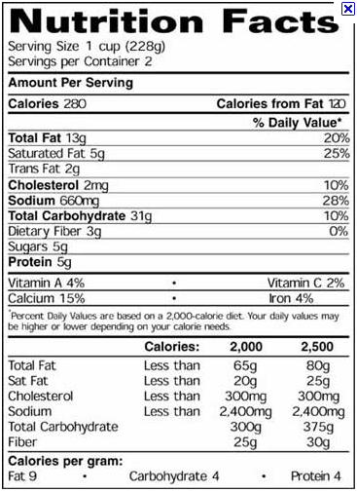
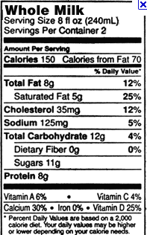
Suzy Q ate these two products for lunch:
How much %Daily Value of Calcium did she eat?
How much more should she eat in the day to consume her daily recommendation?
What are some foods she can eat to add more calcium in the day?

Slide 11
Suzy Q ate these two products for lunch:
How much %Daily Value of Calcium did she eat?
45%
How much more should she eat in the day to consume her daily recommendation?
130-45= 85%
What are some foods she can eat to add more calcium in the day?
Milk, yogurt, cheese, broccoli, almonds, etc

Slide 12
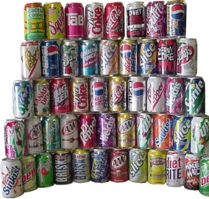
Things to AVOID
Soda
  If you drink a lot of soda and sugary beverages you might not be getting enough calcium and vitamin D.
  Sugar in sodas can also damage your teeth.
  Try to replace soda with water, milk, or fruit juices with added calcium to build strong bones!

Slide 13


Things to AVOID
Alcohol
  Underage drinking can be deadly, but it also damages your bones
Smoking
  The toxic chemicals in cigarettes damage many of the cells in your body that help build strong bones.
To build strong bones I am alcohol and tobacco free!!

Slide 14
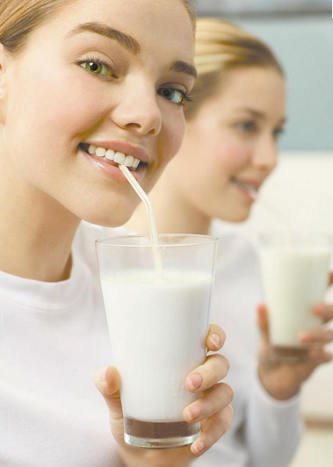
Calcium and YOU
To have strong bones as you grow older, you must build strong bones now!
  Bones will be their strongest at age 20, so it is important to eat enough calcium each day as a teenager.
The choices you make today will affect your bones for life!

Slide 15
Discussion
How can you prevent Osteoporosis?
Why is it important to eat calcium AND vitamin D?
What foods have you eaten today that contained calcium?
What foods do you like that are high in calcium and how can you add them to your diet?

